Slide 1
CMPE 256
Large Scale Analytics
Research Paper based recommendation
-based on Hybrid and Multi model
Presented By: Team 02
Rama Tejaswini Thotapalli(013785681)
Nithya Kuchadi (013769665)
Pranjal Kumar Patel (013748709)
Jaykumar Patel (013756210)
Premal Dattatray Samale(012566333)

Slide 2
Agenda
Problem Statement
Approach
Data Characteristics
Data Preprocessing
Solution Implementation
Solution Evaluation
Website Link: http://ec2-34-217-84-100.us-west-2.compute.amazonaws.com/

Slide 3
Problem Statement
Researchers spend too much time and struggle to find the suitable article they are looking for.
The problem becomes worse when a researcher with insufficient knowledge of searching research articles.
How to formalize and solve the recommendation problem?
In the traditional recommendation approaches, The results of the query miss many high-quality papers,which are either published recently or have low citation count.

Slide 4
Literature Survey
Methodologies | Limitation
Collaborative filtering | cold start problem, does not capture the semantics of the user interests
Matrix factorization based methods | usually time consuming, and it would become even more challenging when the paper collection is extremely large
citation-based method | problem with this technique arises when there is an absence of citation in the text corresponding to the references added in the reference list. These citations are known as false citations and such citations also lead to inappropriate results
Google’s PageRank | Major drawback is that it uses citation count as a metric to recommend articles which fails to recommend quality articles when recently published paper is selected as the paper of interest .
Content based filtering | The model can only make recommendations based on existing interests of the user. In other words, the model has limited ability to expand on the users' existing interests.

Slide 5
Our Approach
To overcome all the limitations of the above mentioned approaches and as we have large set of data, we are using the below mentioned models with features like title and abstract, References, Citations and Author.
Content Based
TF-IDF & cosine similarity
K Nearest Neighbour using Bag of words model and Euclidean Distance.
Word2Vec model, Cosine Similarity
Collaborative Filtering
Pipelined Hybrid System(Sending the result of the Content based Filtering to Collaborative Filtering)
Page Rank Algorithm using Neo4j

Slide 6
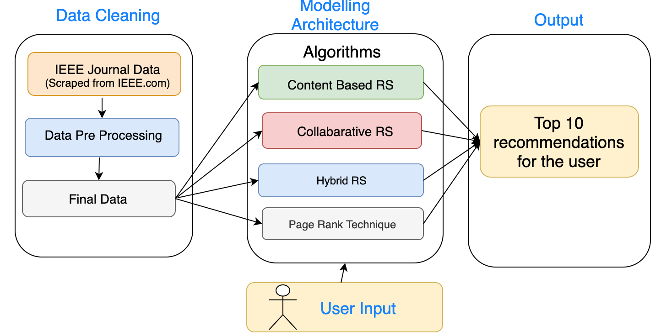
Implementation Block Diagram

Slide 7
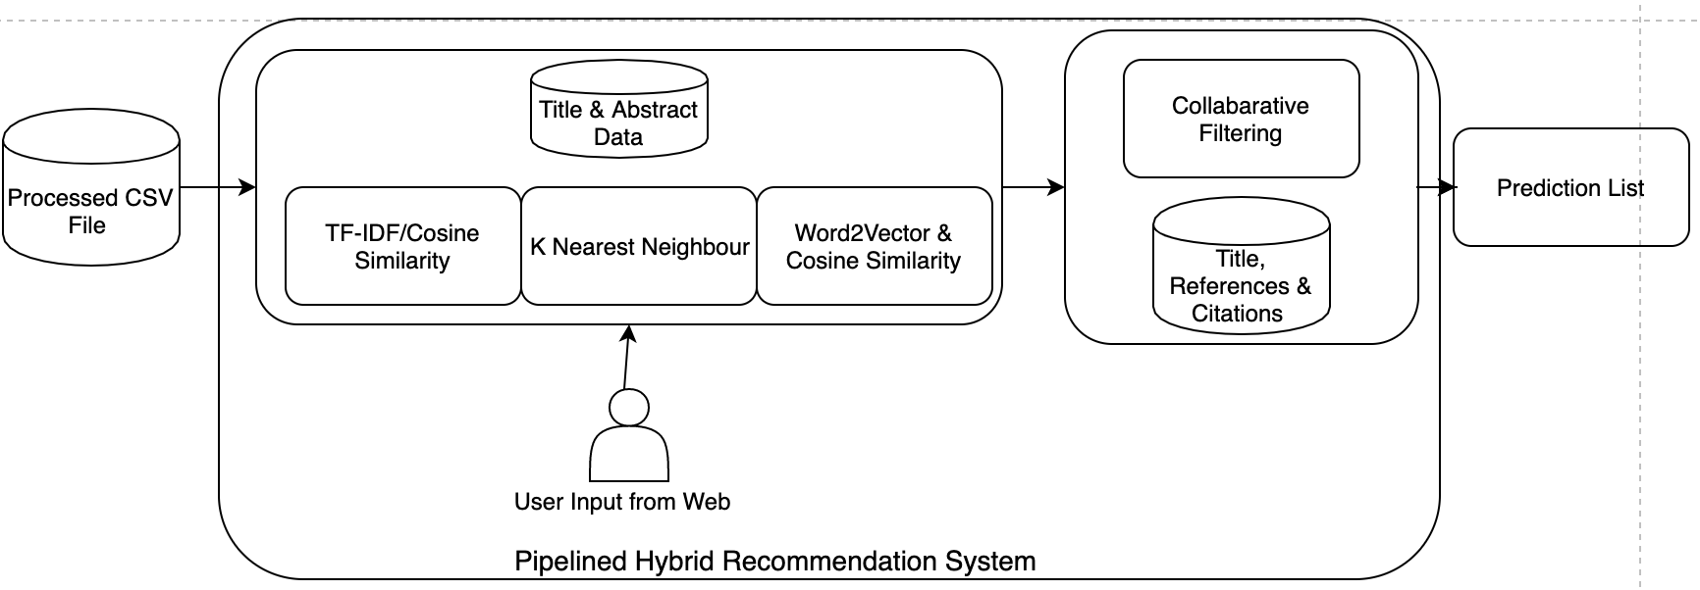
Hybrid RS Architecture Diagram
Content based Recommendation system output is sent to Collaborative Filtering approach

Slide 8
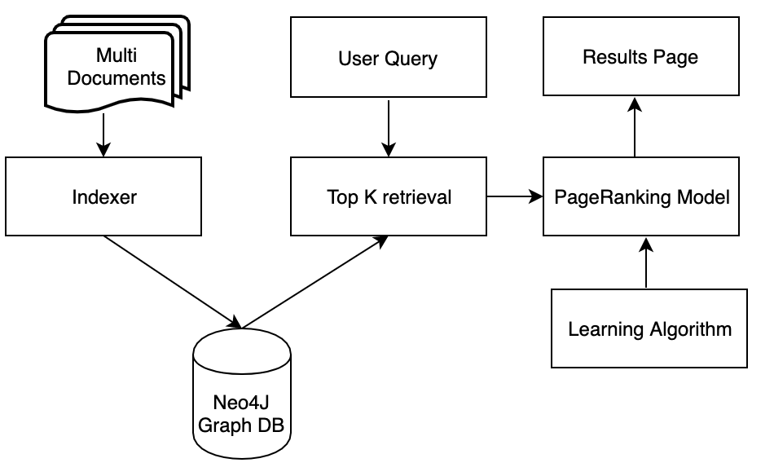
Page Rank Architecture

Slide 9
Acquire Data

Slide 10
Web Scraping
We have scraped the research paper data from the http://www.ieeeorg.com where we have extracted the titles , abstract , References, Keywords, id of the papers. Some of the data we have scraped using Parse hub tool.
Python (3.5)
BeautifulSoup library for handling the text extraction from the web page’s source code (HTML and CSS)
requests library for handling the interaction with the web page (Using HTTP requests)

Slide 11
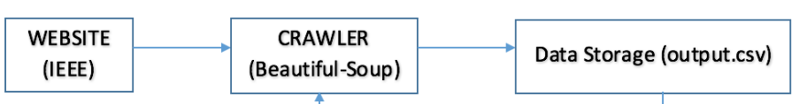
Web scraped data
Using the Beautiful soup framework we will get the entire data into a html where we can search the data using find_ all API of rows, columns and a links.
Once the data is extracted we will store it into the csv file.

Slide 12
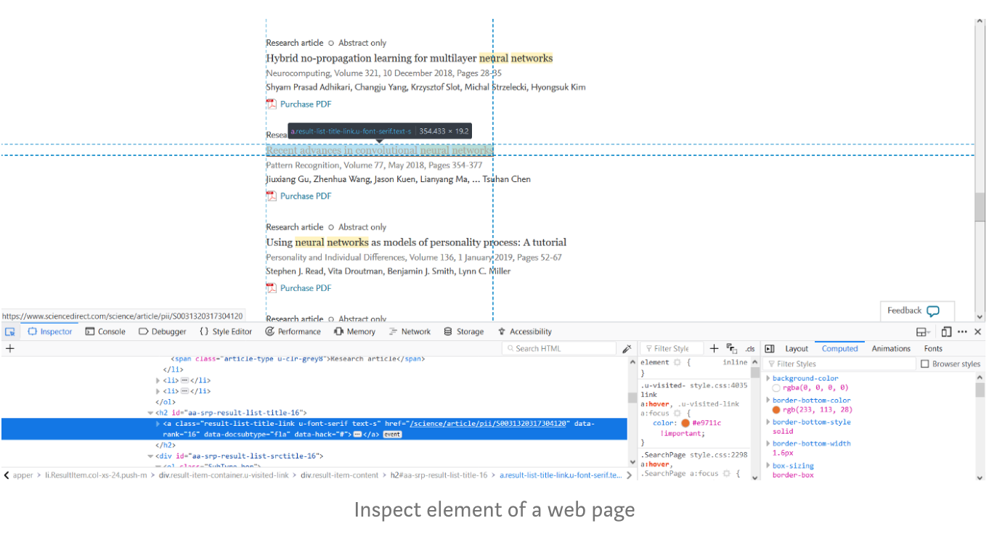
Inspecting the rows and column of the required data

Slide 13
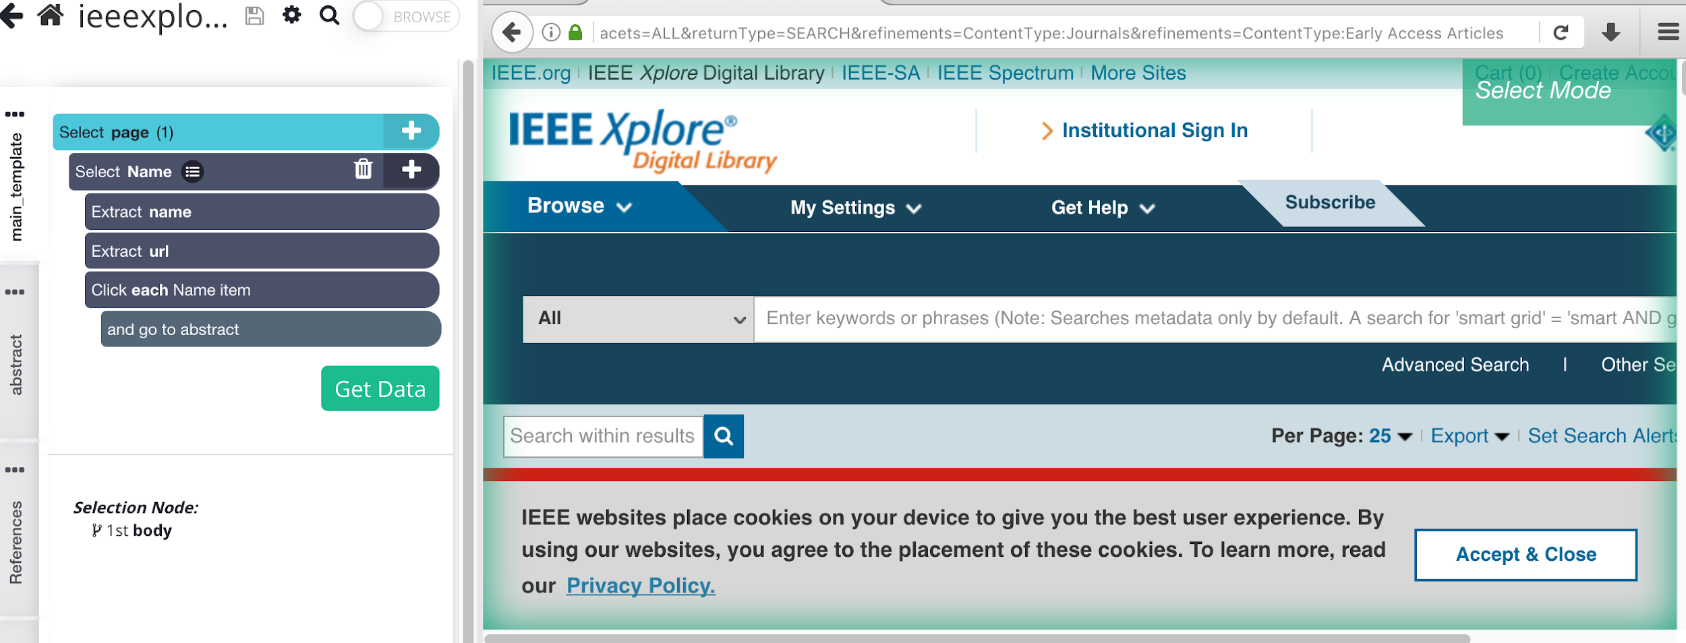
Web Scraping using the Parse hub tool

Slide 14
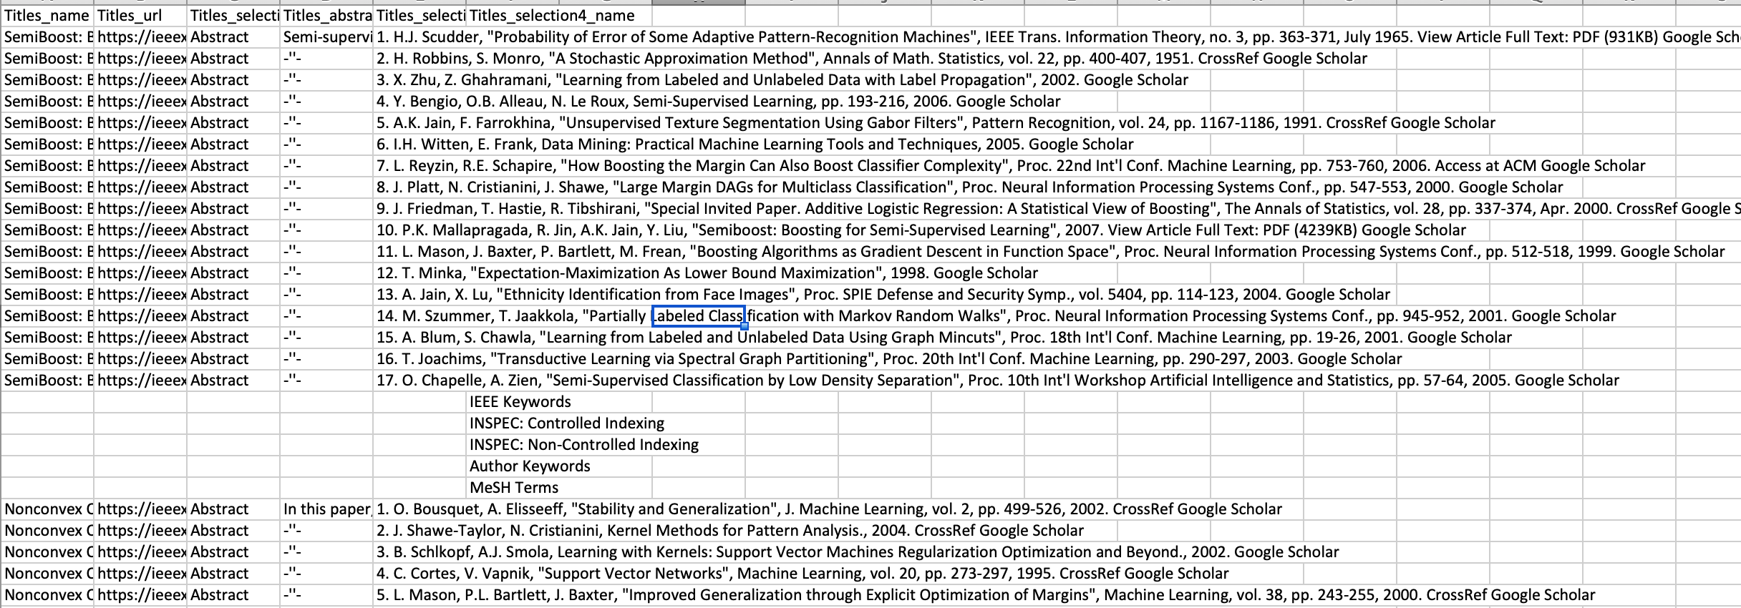
Scraped Data

Slide 15
Data Characteristics
Below is an example:
{"authors": [ "Leon A. Sakkal", "Kyle Z. Rajkowski", "Roger S. Armen" ],
"n_citation": 0, "references": [ "4f4f200c-0764-4fef-9718-b8bccf303dba", "aa699fbf-fabe-40e4-bd68-46eaf333f7b1"],
"title": "Prediction of consensus binding mode geometries for related chemical series of positive allosteric modulators of adenosine and muscarinic acetylcholine receptors",
"venue": "Journal of Computational Chemistry","year": 2017,
"id": "013ea675-bb58-42f8-a423-f5534546b2b1"
"abstract": "In this paper, a kind of novel jigsaw EBG structure is designed and applied into conformal antenna array. The stop band of jigsaw EBG structure is simulated. And the 4-element antenna array with Taylor amplitude distribution is considered. The effect of EBG structure on the side-lobe level of antenna array radiation pattern is investigated."
}

Slide 16
Data Pre-Processing Steps
We need to extract different data for different algorithms, But before that the complete data should be processed.
Cleaning of the data should be done before sending this data to models as some of the columns has
1. Null Values
2. Sparse Data
3. Some papers do not have title and abstract; some have title only without abstract and some have abstract without title

Slide 17
Data Pre-Processing Steps
The fields ‘paper authors’ , ‘citation number’, ‘paper venue’ ,’published year’ are dropped from the csv file.
Removing the records, which do not have title
Replacing the records’ null abstract with title where there is no abstract
The extracted text is cleaned such that only english words are contained in the csv file.

Slide 18
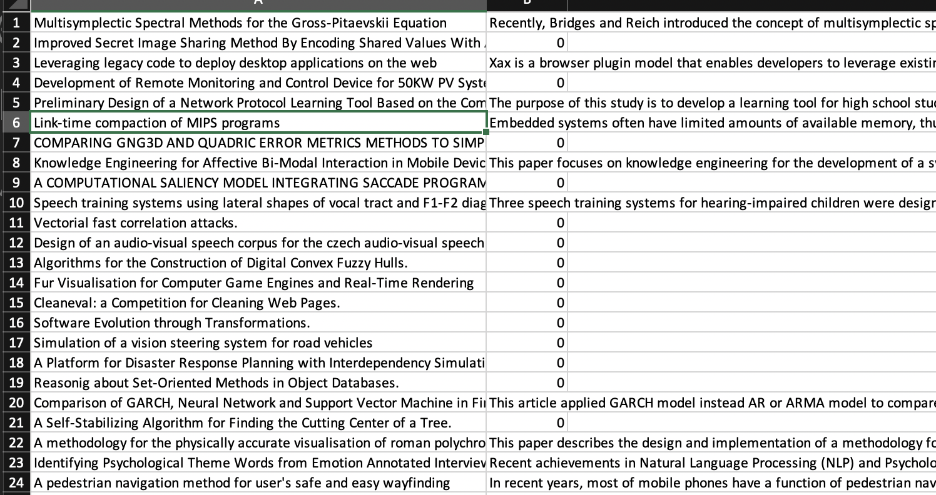

Slide 19
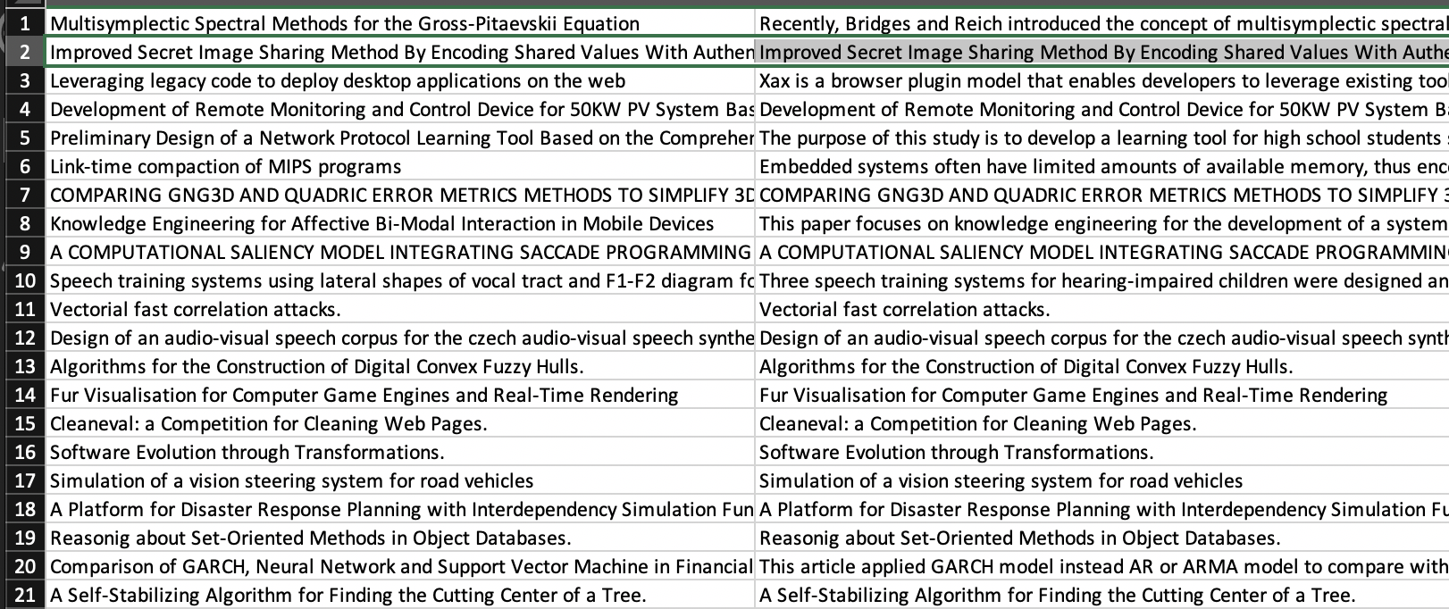

Slide 20
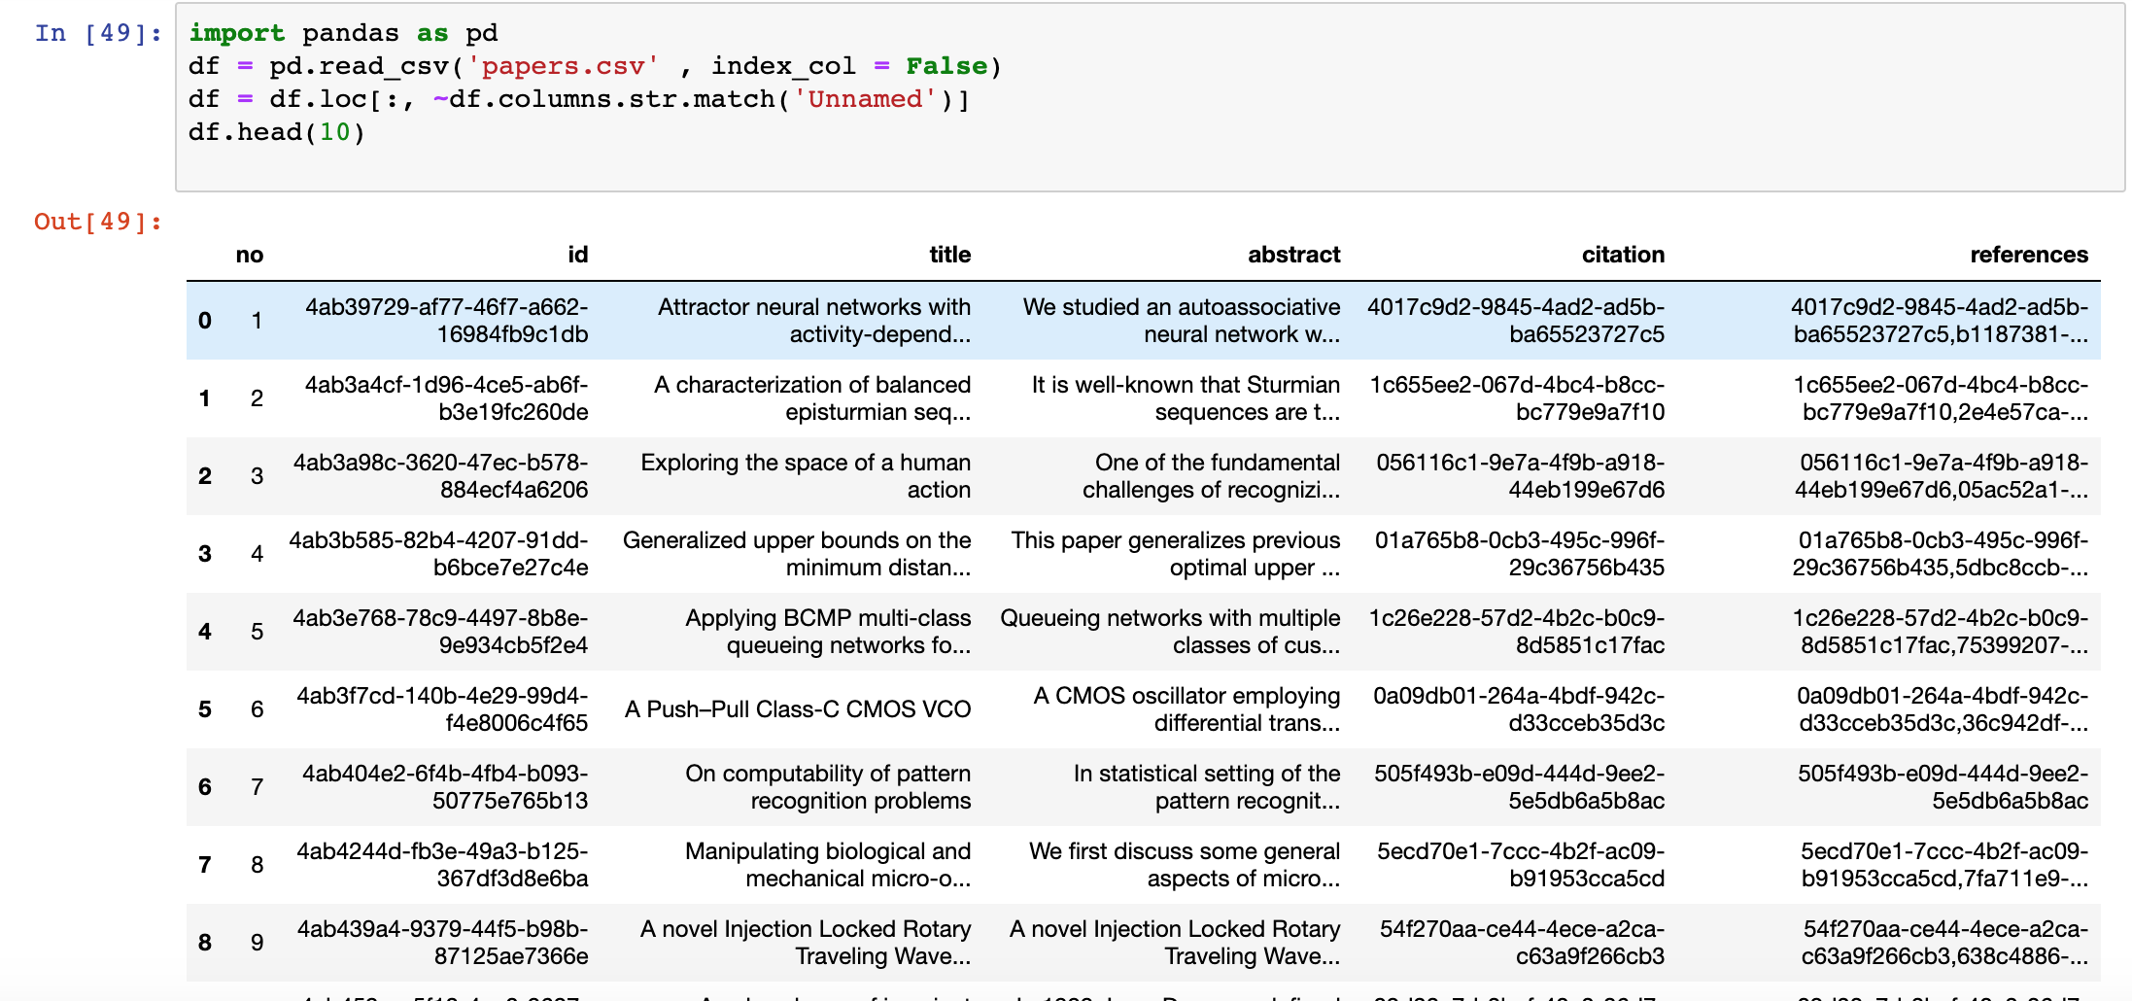
Final Data after Preprocessing

Slide 21
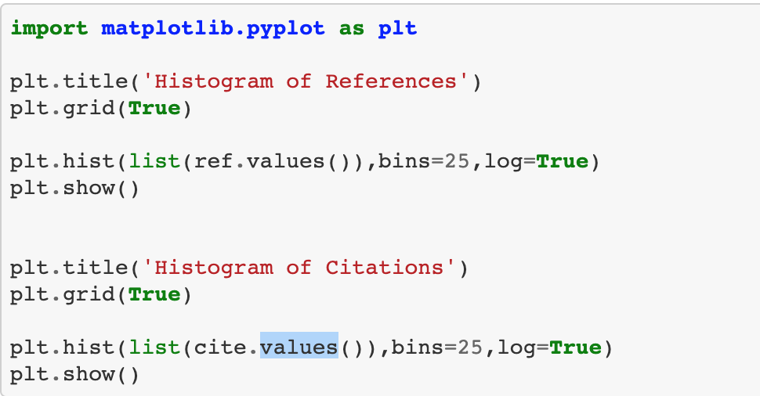
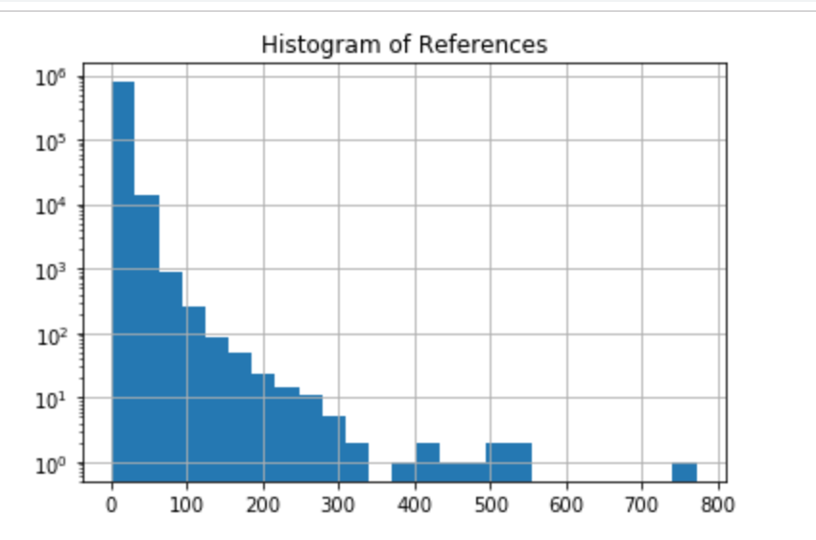
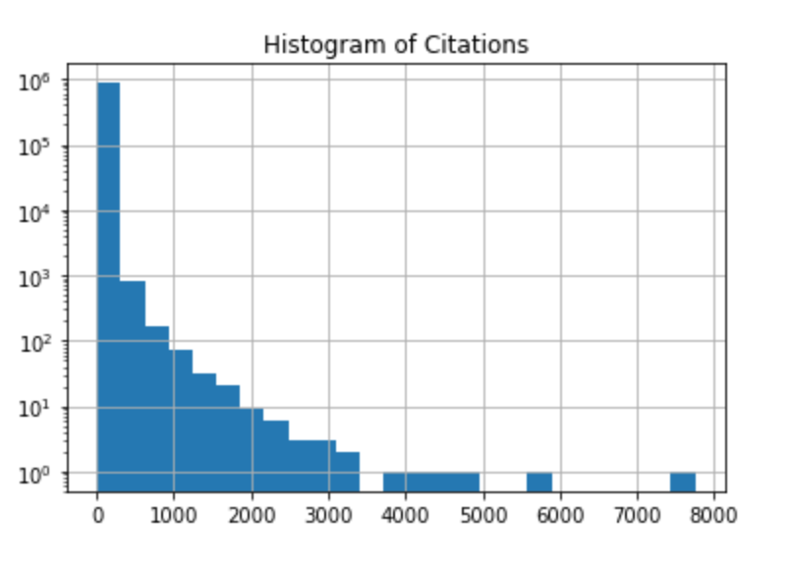
Exploratory data Analysis

Slide 22
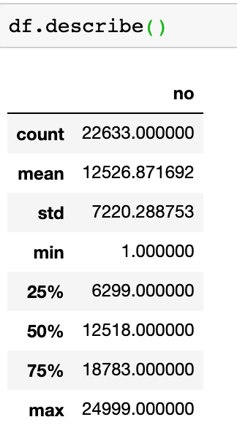
In Exploratory data Analysis
we will describe the data
Characteristics and data statistics in
plots and provide visual understanding
of data.

Slide 23
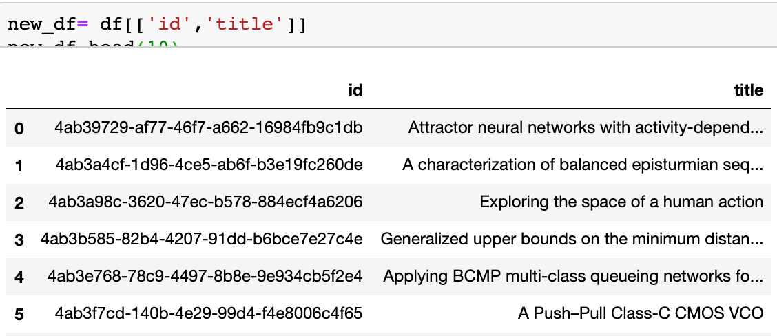
Data for final model for Content Based Approach

Slide 24
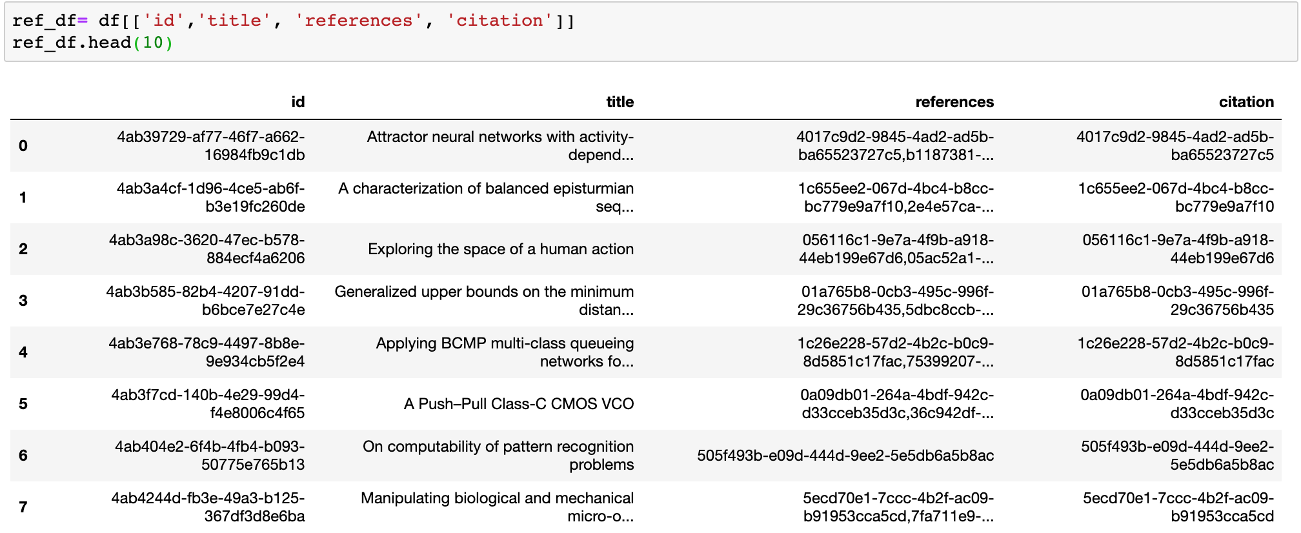
Data taken for Collaborative Approaches

Slide 25
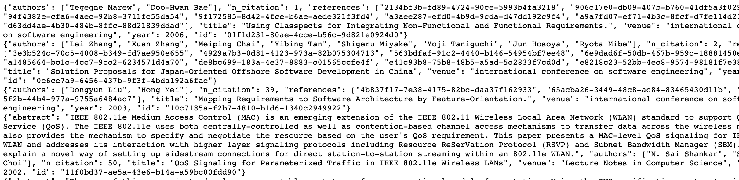
Data taken for Pagerank Approach
The data taken into page rank algorithm is the Json file of the same data which is directly loaded into the Neo4j Graph Database

Slide 26
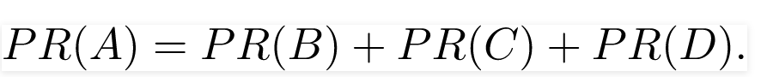
PageRank Implementation
PageRank is a way of measuring the importance of website pages. PageRank works by counting the number and quality of links to a page to determine a rough estimate of how important the website is.
In Simple , If B, C, D links to A then page rank of A is

Slide 27
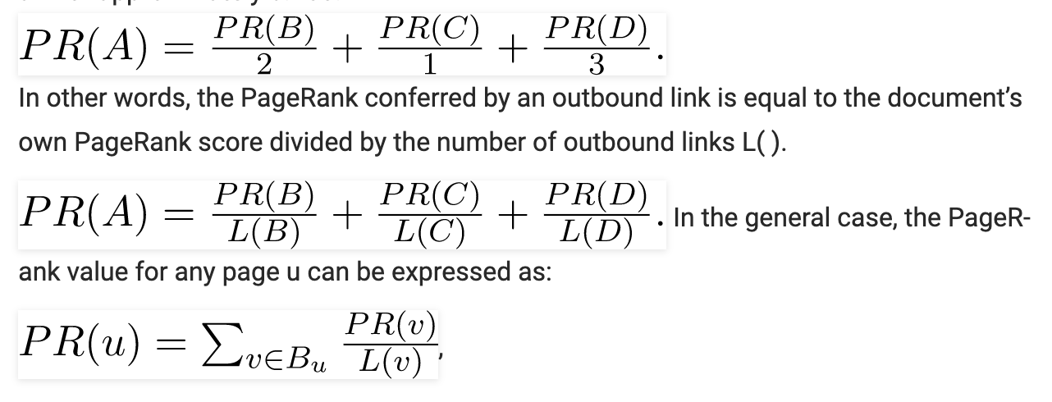
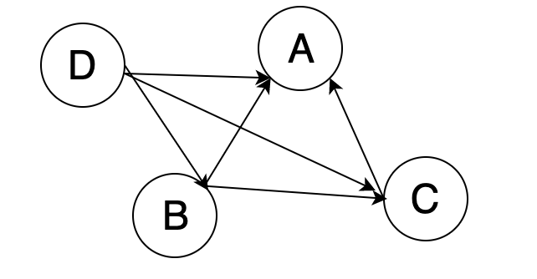
Detailed Example
Suppose if B had a link to pages C and A, page C had a link to page A, and page D had links to all three pages. Then the page rank of A is
B-->A,C; C-->A; D-->A, B, C

Slide 28
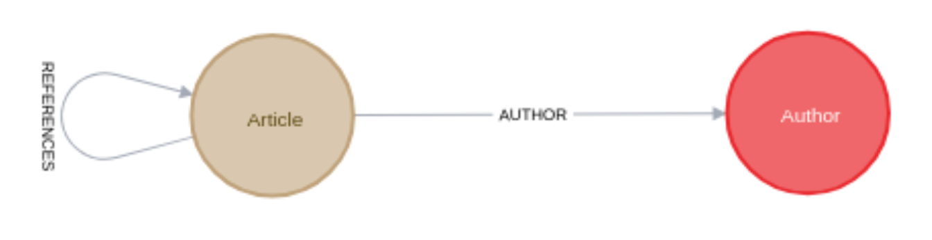
Implementation
Used below tools and library for the implementation of recommendation system
Neo4j
Neo4j graph algorithms
Neo4j APOC
Graphaware’s NLP plugin
Taken the below mentioned graph for the connection between the articles and references

Slide 29
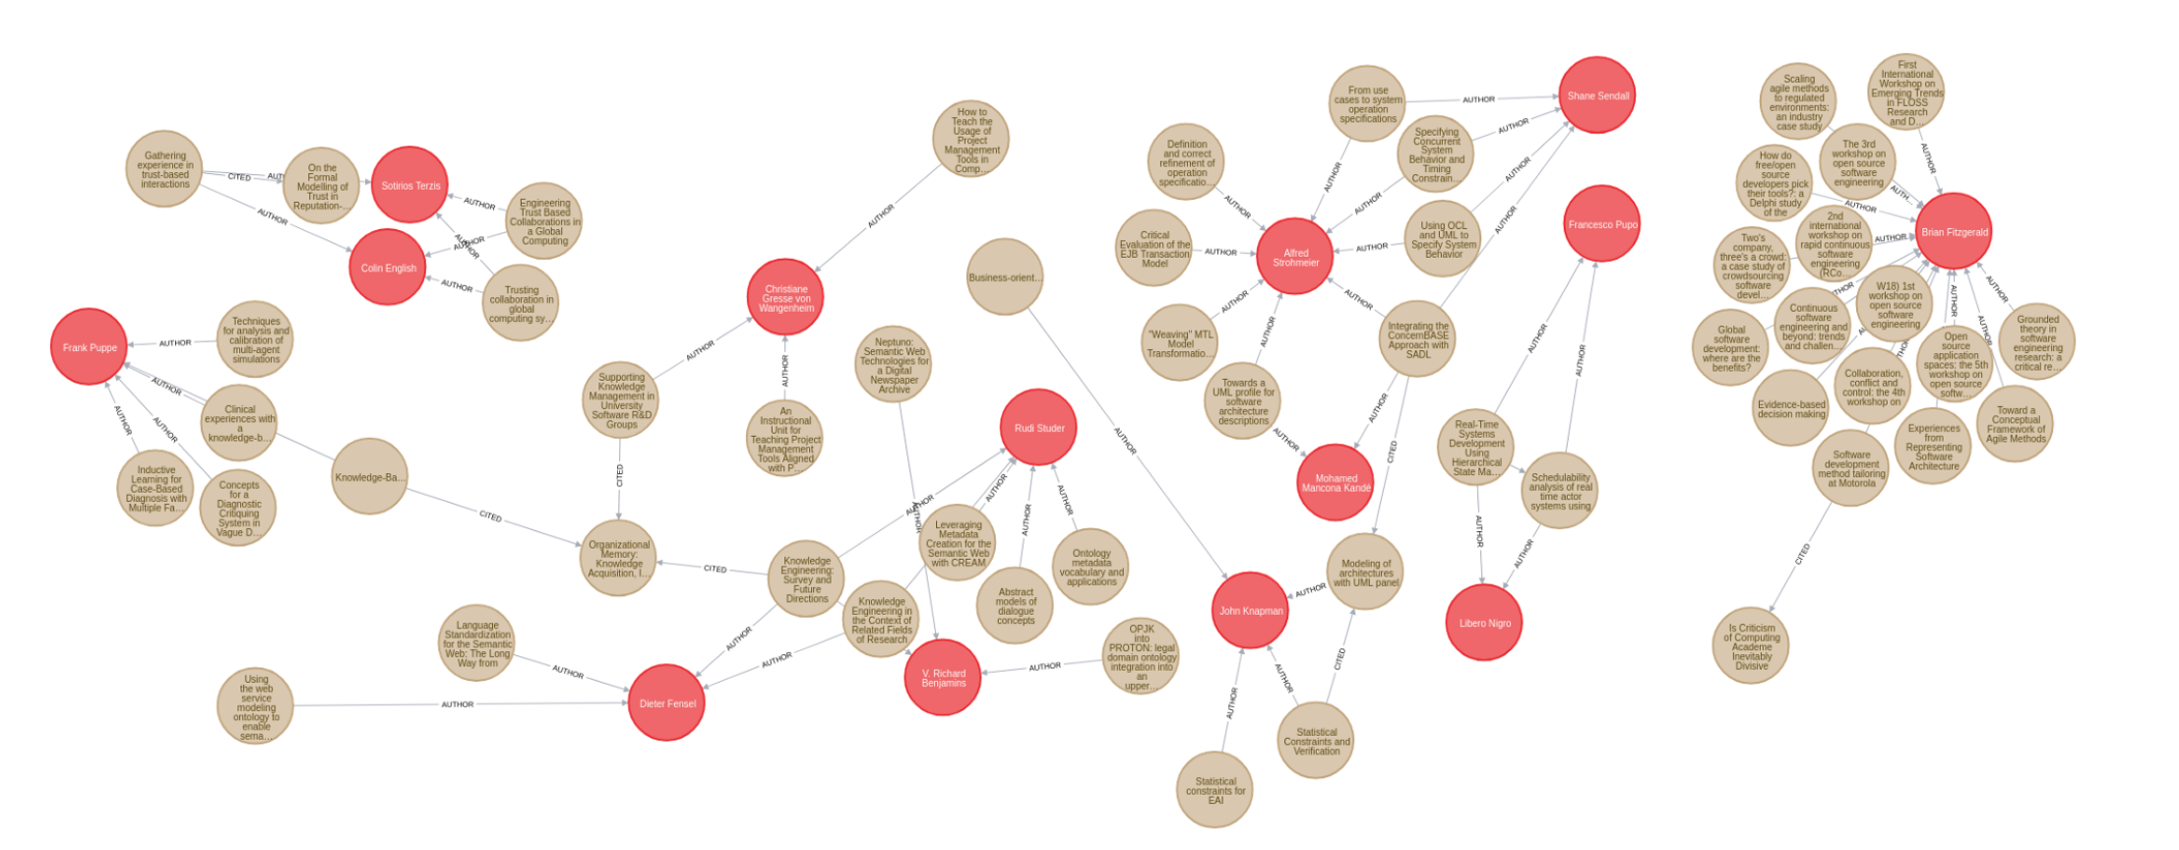
Article and Author Network Graph

Slide 30
PageRank Algorithm
Store the data into Neo4j graph database.
Search the database with the titles of the search word
If the records found then the records will be sent to the pagerank algorithm of networkX which will evaluate the page rank of the articles.
The articles which are more relevent and has highest Pagerank will be provided to the User

Slide 31
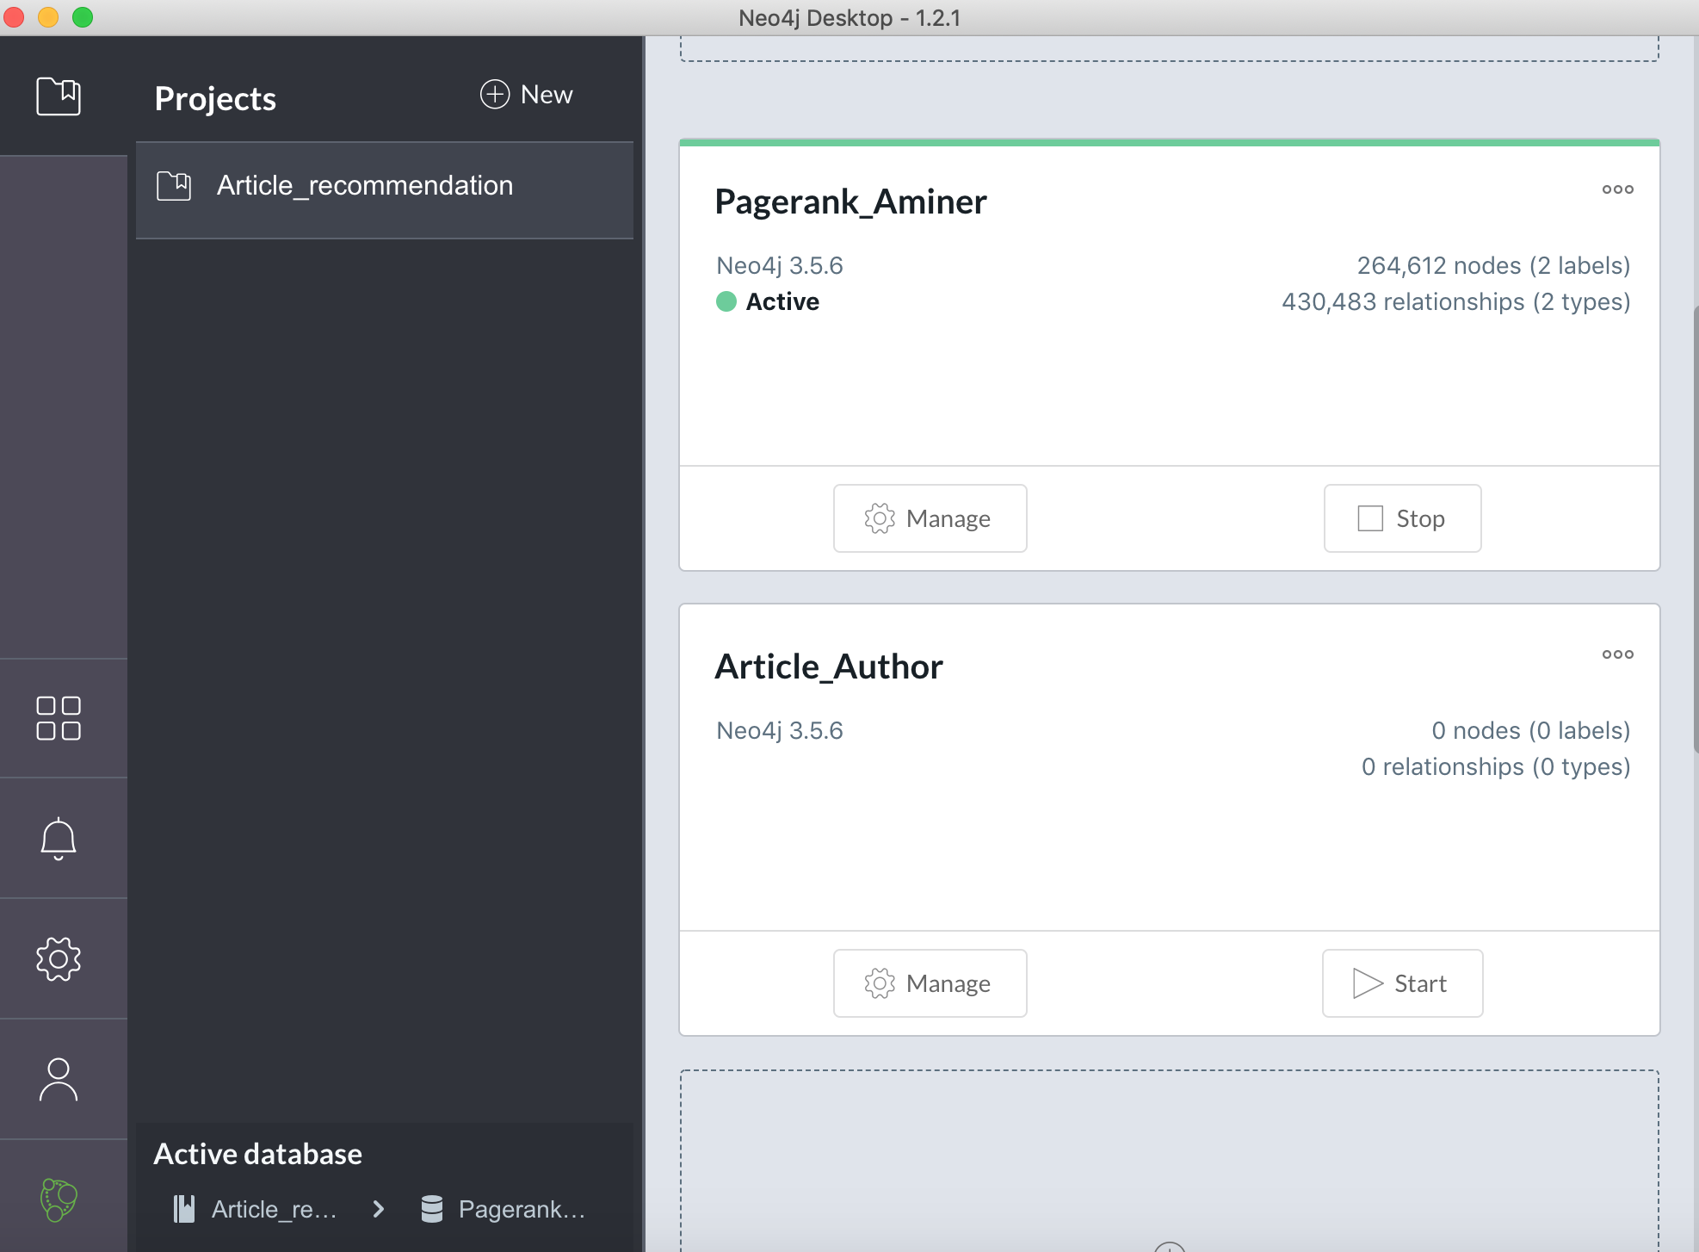
Neo4j Desktop View

Slide 32
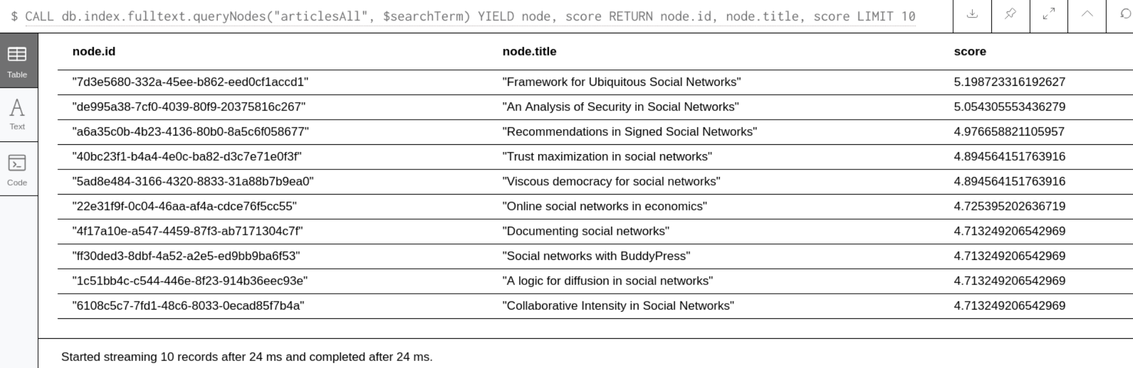
Queries given to Neo4j to search the word in the database.
CALL db.index.fulltext.queryNodes("articlesAll",$searchTerm)
YIELD node, score RETURN node.id, node.title, score
LIMIT 10
Here the search term is suppose Social Networks

Slide 33
Now we will call the pagerank procedure to get the pagerank of each article
CALL db.index.fulltext.queryNodes("articlesAll", $searchTerm)YIELD node
WITH collect(node) as articles
CALL algo.pageRank.stream('Article', 'REFERENCES', {
sourceNodes: articles})
YIELD nodeId, score
WITH nodeId,score
ORDER BY score DESC
LIMIT 10
RETURN algo.getNodeById(nodeId).title as article, score

Slide 34
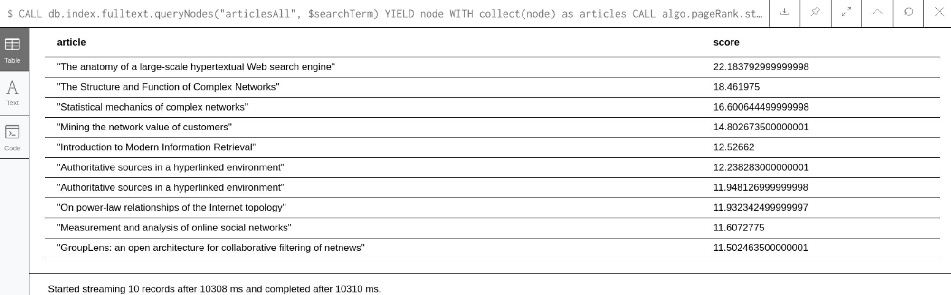
Final Titles of articles of the search term ‘Social Networks’

Slide 35
Content Based Filtering
To recommend papers based on the titles.
Implemented 3 models
1. TF-IDF & Cosine similarity
2. K Nearest Neighbors
3. Word2Vec

Slide 36
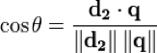
TF-IDF & Cosine Similarity
Tf-idf is a transformation you apply to texts to get two real-valued vectors.
●TF: Term frequency. This is simply the frequency of a word in a document.
●IDF: Inverse Document Frequency . This is the universe of document frequency among the whole corpus of documents.
Cosine similarity of any pair of vectors by taking their dot product and dividing that by the product of their norms. That yields the cosine of the angle between the vectors.If d₂ and q are tf-idf vectors.

Slide 37
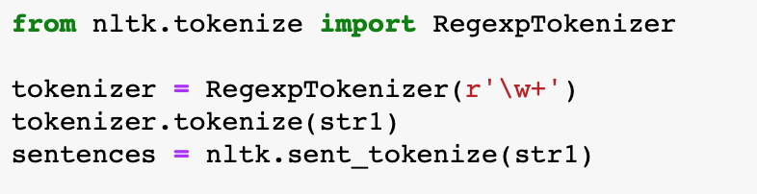
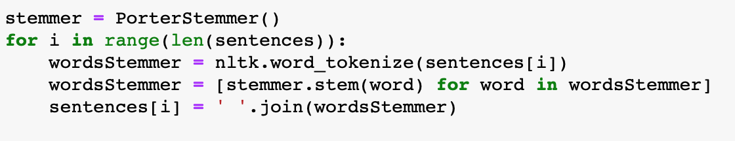
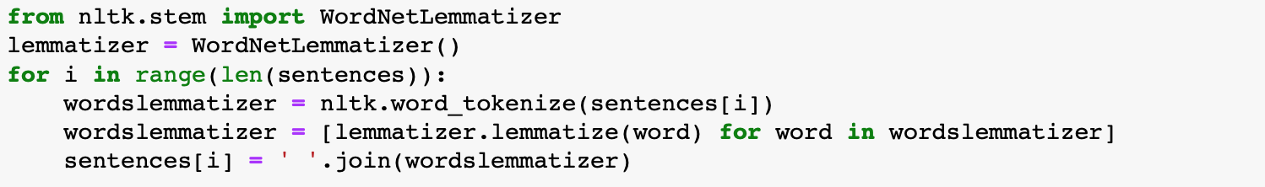
TF-IDF & Cosine Similarity

Slide 38
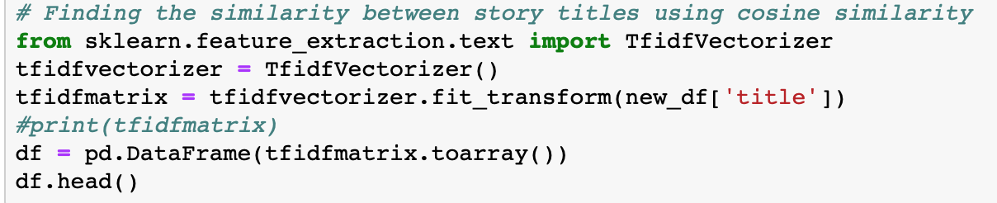
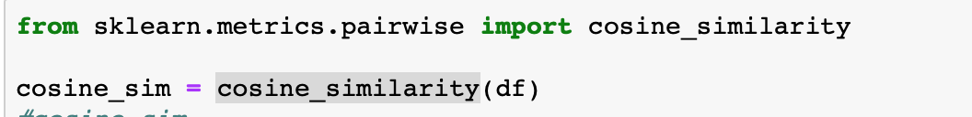
TF-IDF Implementation

Slide 39
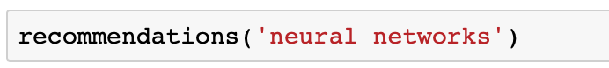
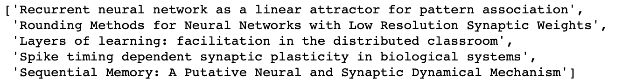
TF-IDF Result
Input:
Output:

Slide 40
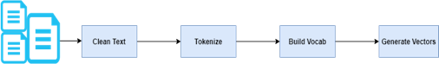
K Nearest Neighbors
For a given target paper, KNN algorithm uses Bag of Words model and Euclidean distance to recommend K nearest papers from the dataset.
A bag-of-words model is a way of extracting features from text for use in modeling, such as with machine learning algorithms.

Slide 41
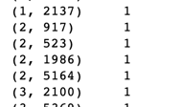
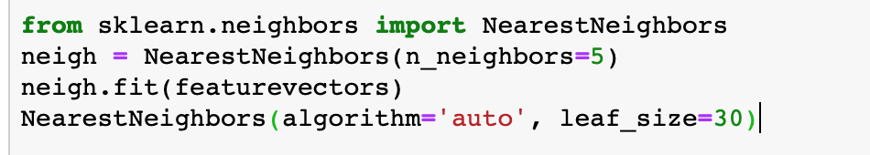
KNN Implementation
KNN

Slide 42
KNN Result
Input:
Output:

Slide 43
Word2Vec
Popular machine learning model for generating word embeddings.
It is a two layer neural network
Word Embeddings- Mapping of words in a vector space
Preserves relationship between words
Deals with addition of new words in the vocabulary

Slide 44
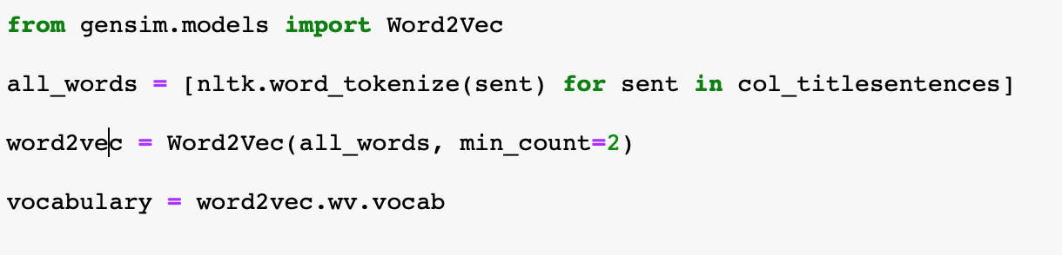
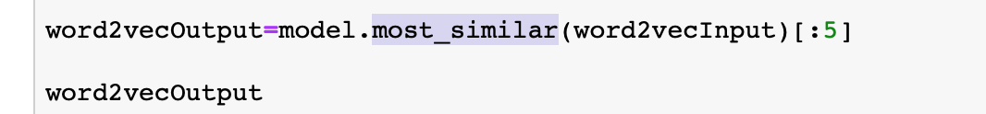
Word2Vec Implementation

Slide 45
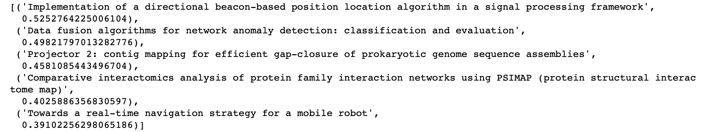
Word2Vec Result
Input:
Output:

Slide 46
Collaborative Filtering
In our Collaborative Filtering approach, a candidate paper is qualified for consideration if and only if it cited any of the target paper’s references and there exist another paper which cited both the candidate and the target papers simultaneously.
Then similarity between the target paper and the qualified candidate papers is calculated and recommend the top-N most similar papers.

Slide 47
major contributions
We utilized the advantages of publicly available contextual metadata to propose an independent research paper that does not require a priori user profile.
Our approach provides personalized recommendations regardless of the research field and regardless of user expertise.

Slide 48
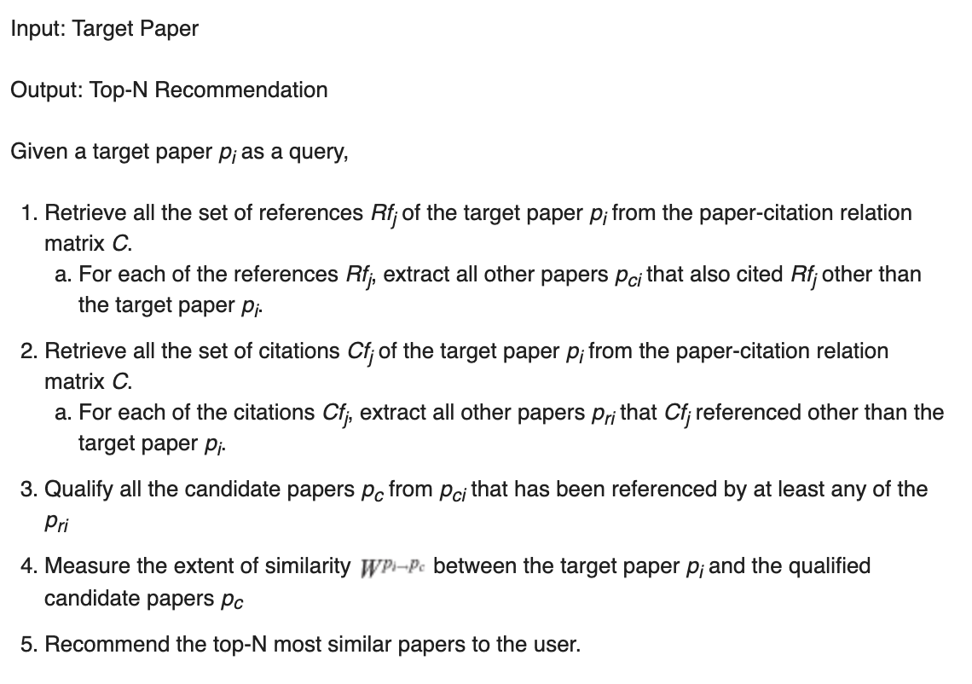
Algorithm

Slide 49
Pipelined Hybrid Model
To combine two approaches, content-based and collaborative filtering to get recommendation at the level of user interface
The cosine similarity is used to find out the research papers based on content (like., title and abstract) and this output is used for collaborative filtering using references of research papers.

Slide 50
Web Application of Research paper Recommendation System
The Web Application Consists of the Content based and Collaborative based and Pipeline Hybrid models (KNN,TFIDF,Word-Vector, Hybrid)
When User provides input and click on Get recommendations it will provide recommendations based of different models.
For system evaluation users are also allow to submit rating for each recommendations and then based on user rating recommendations are evaluated.

Slide 51

Web Application-home page

Slide 52


Slide 53
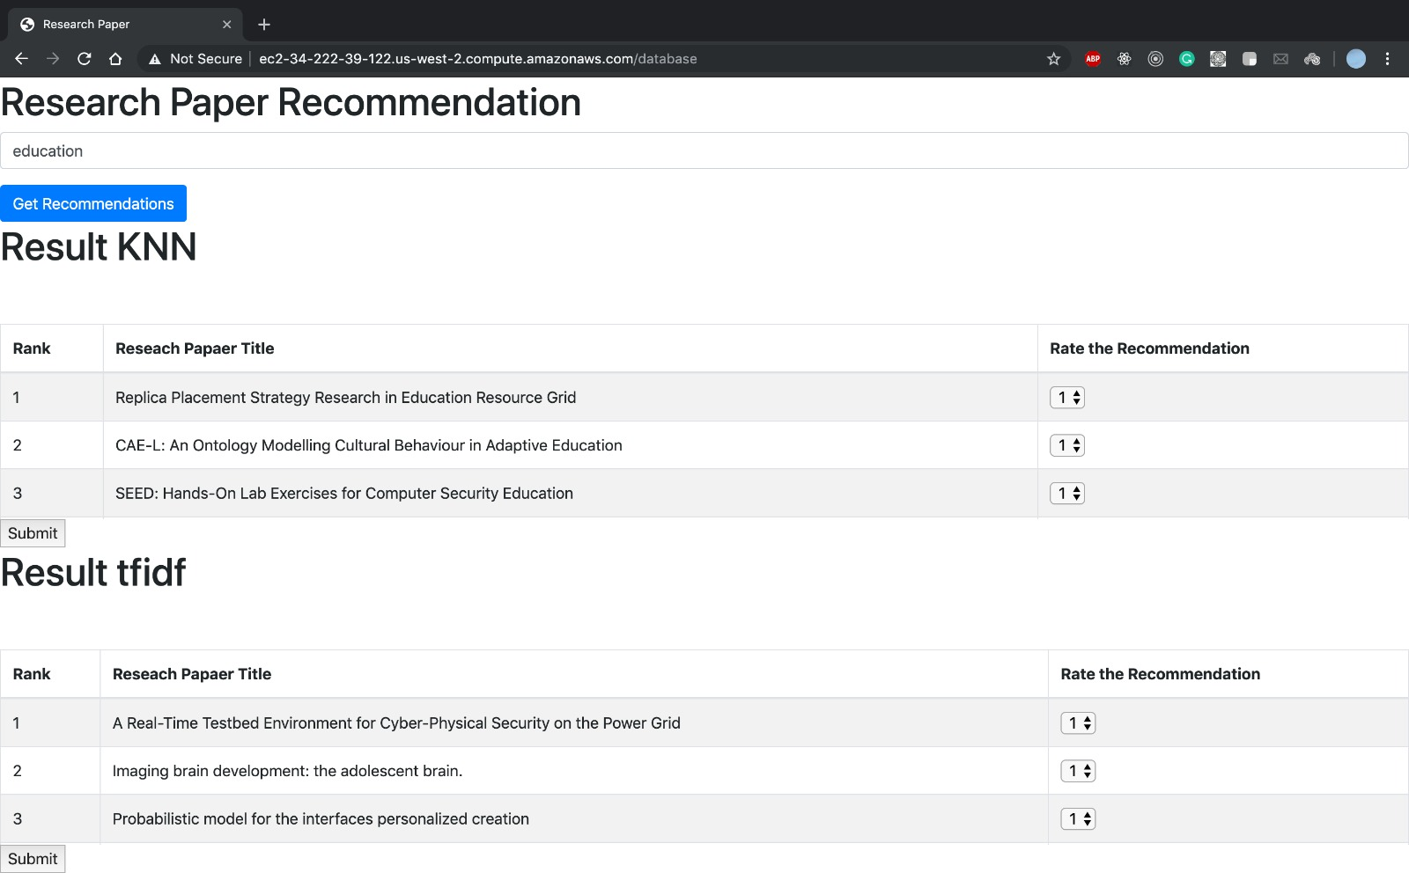
Result of the KNNand TF-IDF Model

Slide 54
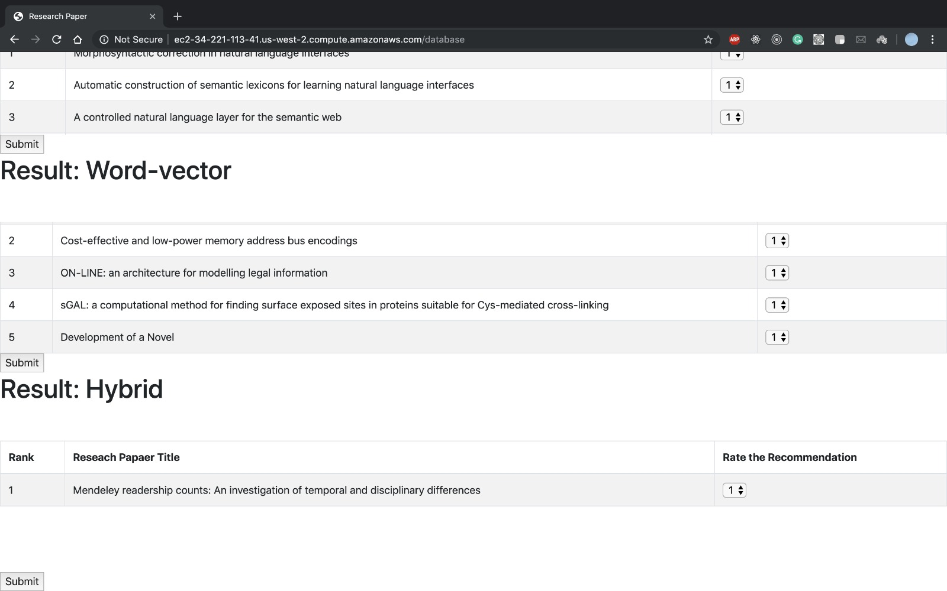

Slide 55


Slide 56
EVALUATION
In the web application user can provide ratings to the each and every research paper he was referred to.
Users will give rating to the recommendations generated by algorithms through a web interface and the algorithm with the highest average rating is considered as the best algorithm.

Slide 57
Conclusion
We have successfully implemented the research paper recommendation based on hybrid and multi model approaches. Moreover provided the detail analysis and comparison report of total 4 models (KNN, TFIDF, Word-Vector and Hybrid). Our experimental evaluation and study shows that hybrid based approach provides better recommendation.

Slide 58
Thank you

